Slide 1
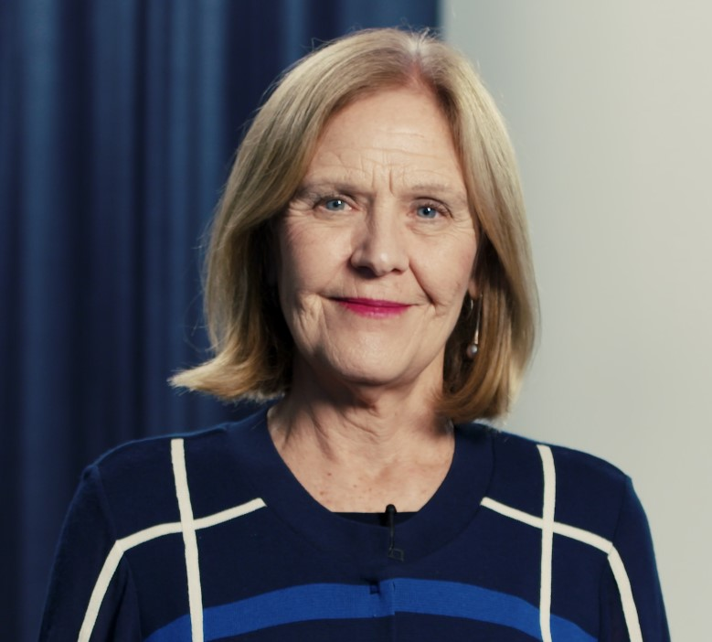
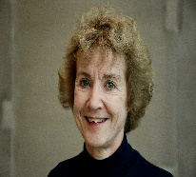
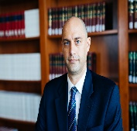
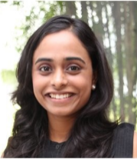
Jane Drake-Brockman
Logo here
Institute for International Trade
The University of Adelaide.
Industry Professor
SPEAKING AT GENEVA TRADE WEEK
Session Title: Competition and Innovation in the Digital Age: Pro Innovation Domestic and International Governance for Digitally-enabled services
Date and Time:
September 29, 2020 09h00 to 10h30 (CEST)
VIRTUAL EVENT
OTHER SPEAKERS:
Hildegunn Nordås
NUPI and Örebro University,
Research Professor.
Pascal Kerneis
European Services
Forum, Managing Director
Bryan Mercurio
The Chinese University of Hong Kong,
Simon FS Li
Professor of Law
Neha Mishra Centre for International Law, National University of Singapore.
Postdoctoral Fellow
REGISTER NOW AT:
genevatradeweek.ch

